Slide 1
Request Processing V0.1 – 2011-02-23
Nguyễn Bá Thành
Software Manager, Game Platform & Integration

Slide 2
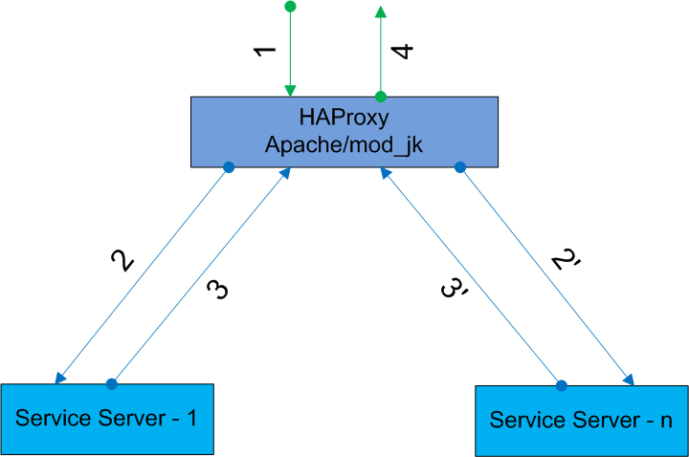
“Level 1”

Slide 3
“Level 1”
Front server receives the request from client
The request is forwarded to one of the service servers
The service server processes the request and returns the result to front server
Front server returns the result to client

Slide 4
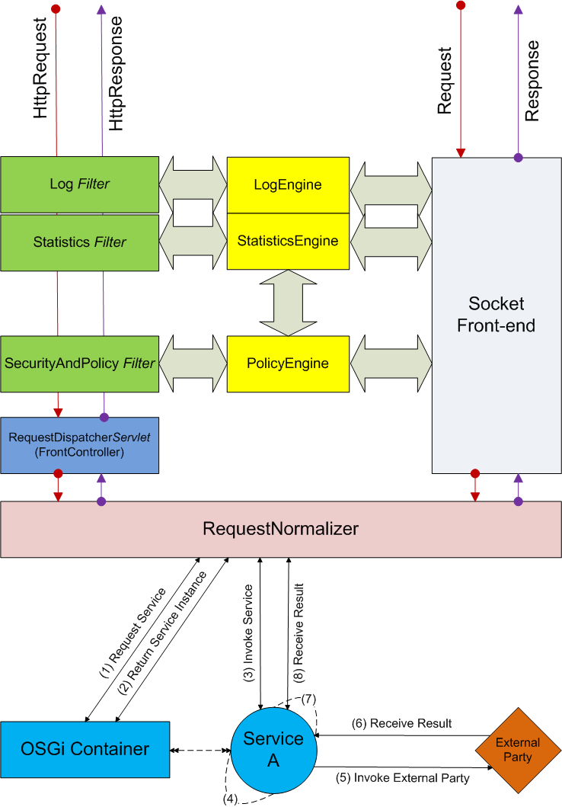
“Level 2”

Slide 5
“Level 2”
RequestNormalizer requests for a service from OSGi container
OSGi container returns the service instance
RequestNormalizer invokes the service API
The service performs pre/processing task
The service invokes external party
The service receives result from external party
The service performs post/processing task
RequestNormalizer receives result from the service

Slide 6
Log Filter
Inspect the HttpRequest & HttpResponse and log the request:
Source: IP Address, Session ID
Destination: service name, service version
Service: serve time (response time)
Data: input sent from source, and output returned from destination
Technology: J2EE Filter
Log information is captured by the filter and sent to LogEngine. LogEngine will actually perform the logging
LogEngine should work asynchronously to avoid lengthening the response time
Detailed rmplementation of LogEngine (db, file system, sysloc, etc) is not finalized at the moment!

Slide 7
Statistics Filter
Inspect the HttpRequest and Maintain system’s statistics (via StatisticsEngine):
Number of requests:
For all services:
All clients: global value (sum of all servers) & local value (this server
Per client: global & local
Per service:
All clients: global & local
Per client: global & local
Request rate (# requests/last minute):
For all services:
All clients: global value (sum of all servers) & local value (this server
Per client: global & local
Per service:
All clients: global & local
Per client: global & local

Slide 8
Statistics Filter (cont)
Error rate (# failed requests/last minute):
For all services:
All clients: global value (sum of all servers) & local value (this server
Per client: global & local
Per service:
All clients: global & local
Per client: global & local
Technology: J2EE Filter
Detailed implementation of StatisticsEngine is not finalized at the moment!

Slide 9
SecurityAndPolicy Filter
Inspect the HttpRequest and ask PolicyEngine if request is allowed:
Check if client is allowed to access the service.
Check if request rate from the client exceeds the threshold.
Technology: J2EE Filter
Detailed implementation of PolicyEngine is not finalized at the moment!

Slide 10
RequestDispatcherServlet
Receive the HttpRequest and pass it to the RequestNormalizer’s API
Technology: J2EE Servlet
Pseudo code:
requestHandler = getRequestNormalizer(); requestHandler.process(httpRequest, httpResponse);

Slide 11
RequestNormalizer
Provide API to transform the request (HTTP, TCP Socket) to OSGi service call
Technology: Java
Pseudo code:
//extract information from the request //wrap the request info into a RequestInfo object … osgiManager = getOsgiManager(); service = osgiManager.getService(serviceName, serviceVersion); service.execute(requestInfo, responseStorage) … //transform and return the response data

Slide 12
Socket Front-end
Handle requests via TCP socket
Technology: Java
The Socket Front-end can not take advantage of J2EE Filter, but it can contact the LogEngine, StatisticsEngine and PolicyEngine to log the request, update statistics and authorize the request

